Slide 1


Cross-platform Mobile Development with C#
Xamarin and MvvmCross

Slide 2
The Future Is Mobile!
Facebook posts
Emails (read)
Tweets
60 %
75 %
90 %
Bill Boorman, ATC 2012

Slide 3
Agenda
Introduction 10’ olb
Building the “Zühlke X-Platform Messenger” 45’ ssh/urb
Role playing
Live coding
Questions 5’
MyBosch App 10’ kwl
Zühlke as Xamarin’s Premium Consulting Partner 10’ kls
Discussion 10’

Slide 4
Web, Hybrid or Native?
jQuery Mobile
PhoneGap
Xamarin
Criteria | Web | hybrid | native
User Experience |  |  | 
Performance |  |  | 
Offline capability |  |  | 
Hardware |  |  | 
Payment models |  |  | 
Multi-platform |  |  | 
Abstraction |  |  | 
Deployment |  |  | 

Slide 5
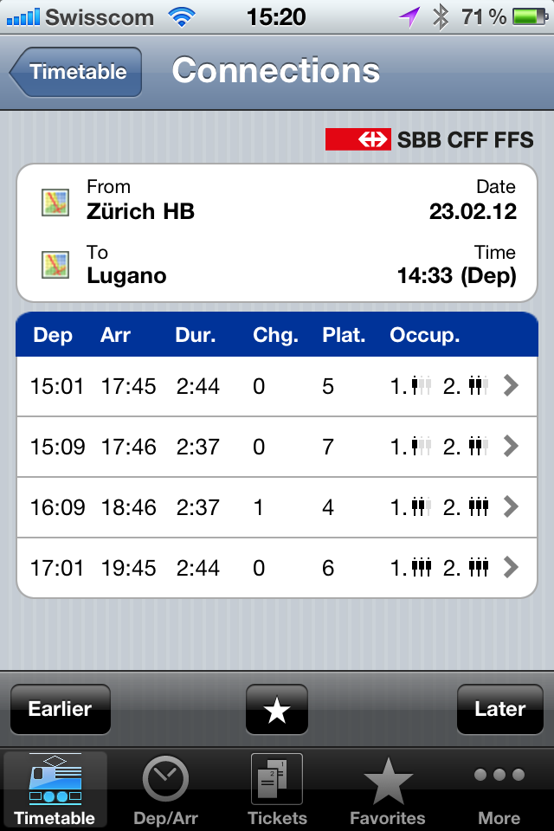
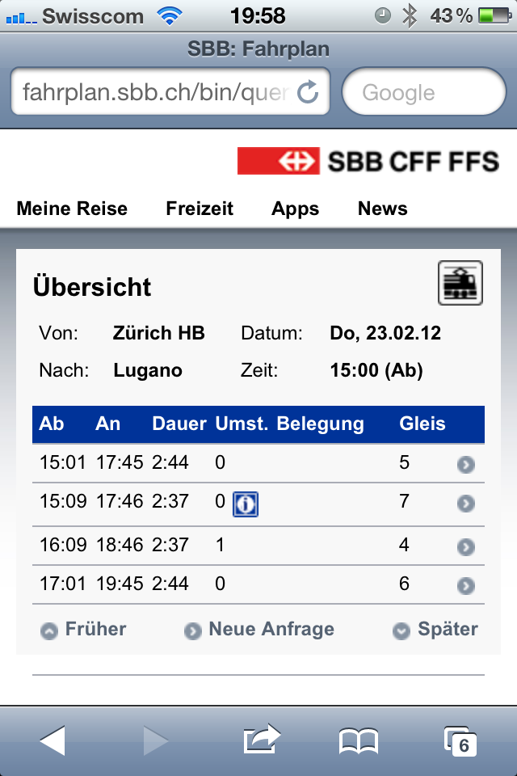
Example: Native vs. Web
Native
Web
Native advantages
Interaction elements
Offline capability (buy ticket)
Hardware support (shake for most recent ticket)
64 %
36 %
Mobile phone time
Nielsen, 2012
Notes:
Swiss Federal Railways
Train schedule
Conductor

Slide 6




Code Sharing Using Xamarin and MvvmCross
Xamarin
MvvmCross
User Interface
User Interface
View
View
View
ViewModel
ViewModel
ViewModel
Model
Model
Model
Business Layer
Business Layer
Business Layer
Service (Azure)
HTTP
HTTP

Slide 7




Team Roles
Customer
Zühlke
Oliver Brack
Product Owner
Stefan Schöb
Android Developer
Windows
Ursin Brunner
iOS Developer
Mac OSX

Slide 8
Initial Position
.NET development team (C#)
Cloud service (Azure) providing a RESTful API
Get users
Send/receive messages
Zühlke X-Platform Messenger
Service (Azure)
Mobile Clients
Android
iOS
Business Layer (.NET) Portable Class Library
HTTP

Slide 9

Tooling (1/2) Android
1
Xamarin Studio or Visual Studio (with plug-in)
Stefan will be using Visual Studio 2012
Project types
Android
“Java Bindings Library” to use existing JAR libraries
iOS
Android project
Folder structure
UI designer (within Visual Studio)
Android simulator

Slide 10

Tooling (2/2) iOS
2
Xamarin Studio
Successor of MonoDevelop
UI design with XCode
Project types
iOS
Android
Plain .NET with C#
Writing iOS apps using C# only (no Objective-C)
Remote debugging from Windows
Using a Mac as build server while developing and debugging from within Visual Studio on Windows

Slide 11
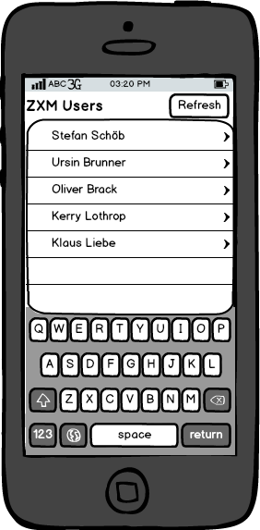
User Interface Mockup
Requirements
User list
Refresh button
Vision
User details
Messages

Slide 12
MvvmCross Setup with NuGet
3
NuGet → Install MvvmCross
Hot Tuna: Most recent release
Prepared solution
Zxm.Android: Android specific code
Zxm.Core: Shared code (client-side) as Portable Class Library (PCL)
Zxm.iOS: iOS specific code
Zxm.Test: Unit tests (client-side)
Zxm.Webservice: REST service (hosted on Azure)

Slide 13


Shared Model/ViewModel (1/2) iOS
4
Model
User class
ViewModel
Derive from MvxViewModel
ObservableCollection for user list
ICommand to load users
View
View (xib) and ViewController (C#)
Table
Button
Data binding with MvvmCross classes/methods
Model
ViewModel
View

Slide 14

Shared Model/ViewModel (2/2) Android
5
Core (user service access)
RestClient (using RestSharp)
Get users asynchronously
Deserializing JSON response using Json.NET
Use MvvmCross as IoC container
View
User list
Fragment (sub activity)
Layout for single user (XML)
Model
View

Slide 15
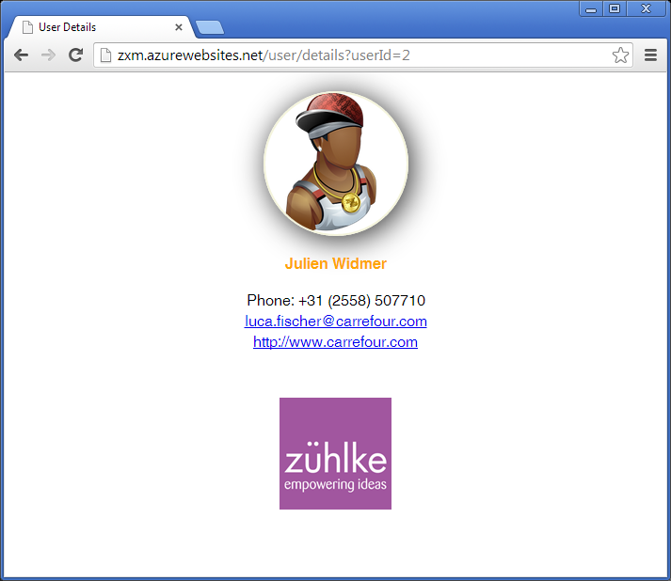
User Details

Slide 16
Including HTML5 Content
6
ViewModel
ViewModel
Create URL based on user ID
ICommand to show user details (on UserListViewModel)
Navigation is also defined in the shared part!
View
WebView (i.e. embedded browser)
View

Slide 17
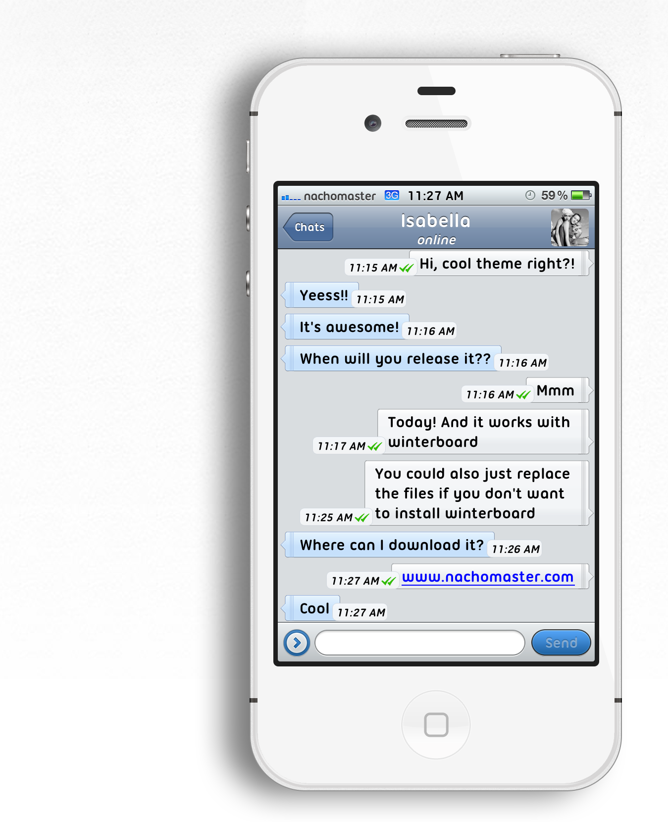
Messages
Requirements
Group chat
Every user can post messages
All users see whole message history
deviantart.com/art/Tweetbot-Skin-for-WhatsApp-Messenger-303033873

Slide 18
Messages
7
Core
Message
MessageService (client-side): Send and receive messages
ViewModel
ObservableCollection for messages
ICommands to load and compose messages
View
Converter to format timestamp (DateTime)
Model
ViewModel
View

Slide 19

What About Security?
What about testing?
How can we ensure proper encryption/decryption?

Slide 20
Client-side Encryption
8
Encryption
Symmetric encryption with AES-256 and shared key
Bouncy Castle implementation
Test Driven Development (TDD)
NUnit as test framework
NSubstitute for mocking
Test our EncryptedMessageService, not the encryption itself (as we are using a tested encryption library)

Slide 21
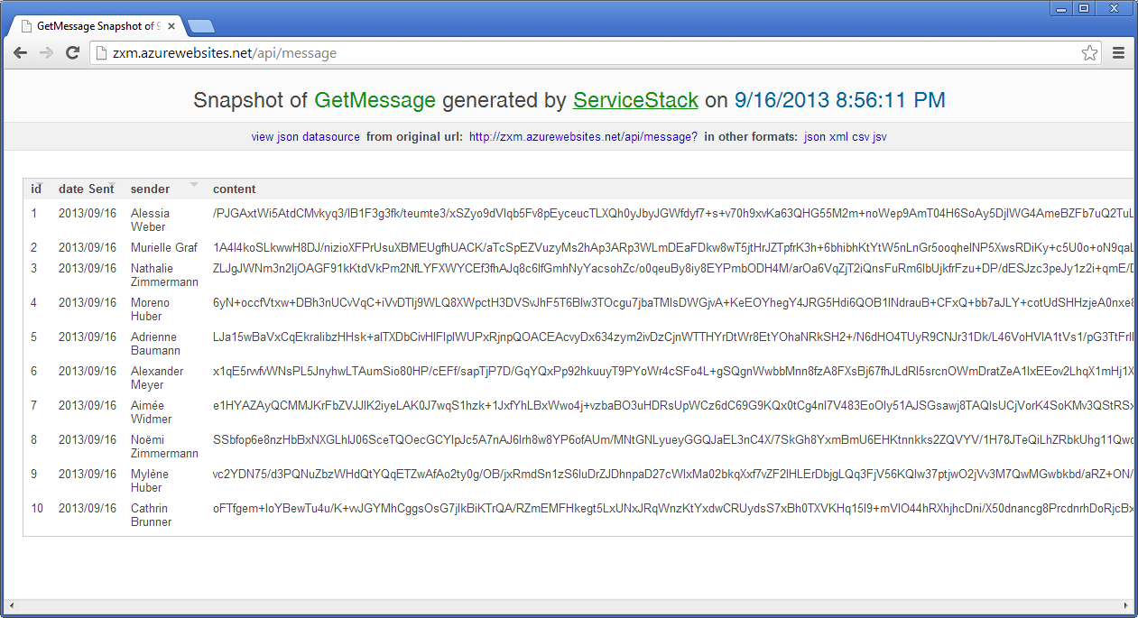
Service Hosting
Encryption demo on server
Service can be hosted on public Cloud (e.g. Azure)

Slide 22
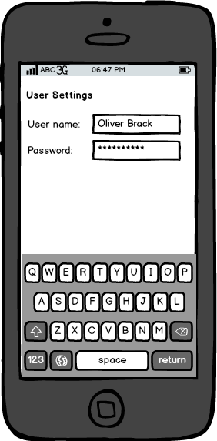
User Settings
Password (encryption key) hard coded
Reverse engineering
Key change needs deployment
Additional requirements
Settings
User name
Password
Individually configurable by user
Persisted independently from application

Slide 23
User Settings
9
SQLite database
Install SQLite (shared interface and proprietary plug-in) using NuGet
Service (client-side) to access database
Full LINQ support to query/manipulate data
User settings
Service (client-side) to load/save settings
ViewModel revealing both username and password
Use password from user settings within encryption service

Slide 24
Conclusion (1/2)
Zühlke X-Platform Messenger
List of all users
User details
Messaging (group chat)
Client-side encryption/decryption (with test)
User settings

Slide 25
Conclusion (2/2)
When to use Xamarin and MvvmCross?
.NET development team (C# as sole project language)
Code sharing
Architecture framework: IoC container, plug-in system, data binding, helpers (e.g. ImageLoader)
Use proven environment and libraries: NUnit, NSubstitute, Bouncy Castle, CI server

Slide 26
Code Metrics
3
Lines of code
Zxm.Android: 162
Zxm.Core: 396
Zxm.iOS: 269
Zxm.Test: 27
Zxm.Webservice: 279
~50 % of code (LoC) is shared
Effort saving is even more significant!
49.5 %
Notes:
UI code is NOT shared, therefore twice as large as shared logic
Strong UI development tools which ease the development/designing of the UI code
Encryption is done with an external library, not included in the metrics
Rather small application and not necessarily representative
XING app: 39% reuse which result in 66% effort reduction (estimation)

Slide 27

Thank You! Questions?
GitHub repository
https://github.com/brunnurs/zxm

Slide 28

MyBosch App (BSH)
Kerry W. Lothrop

Slide 29

Zühlke as Xamarin’s Premium Consulting Partner
Klaus Liebe
Notes:
Zühlke is Xamarin‘s exclusive Premium Consulting Partner in the German-speaking world.

Slide 30

Discussion

Slide 31

About Us
Ursin Brunner
Software Engineer
Schlieren
Klaus Liebe
Business Unit Manager
Frankfurt
Stefan Schöb
Software Engineer
Schlieren
Kerry Lothrop
Lead Software Architect
Frankfurt
Oliver Brack
Nearshoring Manager
Belgrade

